Slide 1
Decision Trees
Missing Attribute Values (during training)
Ignore the training instance
Replace the missing attribute value
Use “missing” as the attribute value
Ignore the missing value but not the rest of the instance
Ignore the training instance when computing information gain for this attribute
If split on the attribute with the missing value, send the instance down each branch of the tree weighted by the proportion of instances from the parent node that move down the branch

Slide 2
Missing Attribute (examples)
Example-1:
young-adult
teen adult
What is the entropy of the instances at the root node AGE?
101 instances, X is missing value for
the split attribute AGE
AGE
A
C
A
B
50 instances
35 BUY
15 SELL
30 instances
20 BUY
10 SELL.
20 instances
5 BUY
5 SELL
10 HOLD

Slide 3
Missing Attribute (examples)
Example-2:
young-adult
teen adult
What is the entropy of the instances at the root node AGE?
What portion of X goes down each of the branches?
101 instances, X is missing value for
the split attribute AGE
AGE
A
C
A
B
50 instances
35 BUY
15 SELL
30 instances
20 BUY
10 HOLD
20 instances
5 BUY
5 SELL
10 HOLD

Slide 4
Missing Attribute (examples)
Example-3:
young-adult
teen adult
What is the entropy of the instances at node B if 20 of them have class value BUY, 10 have class value SELL, and instance X has class value BUY ?
101 instances, X is missing value for
the split attribute AGE
AGE
A
C
A
B
50 instances
+ .5 of instance X
30 instances
+ .3 of instance X
20 instances
+ .2 of instance X

Slide 5
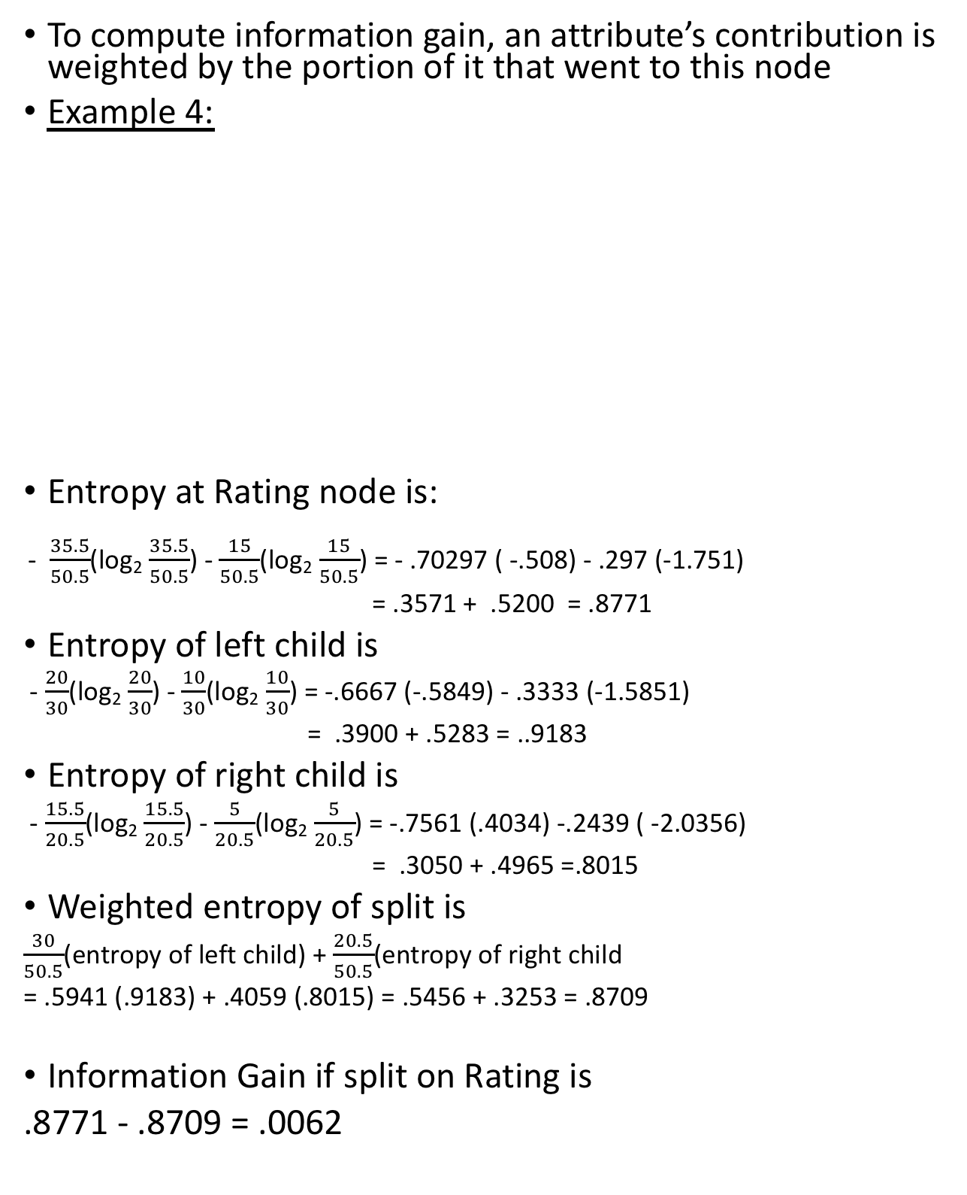
Missing Attributes
To compute information gain, an attribute’s contribution is weighted by the portion of it that went to this node
Example 4:
Entropy at Rating node is:
- $\frac{35.5}{50.5}$(log₂ $\frac{35.5}{50.5}$) - $\frac{15}{50.5}$(log₂ $\frac{15}{50.5}$) = - .70297 ( -.508) - .297 (-1.751)
= .3571 + .5200 = .8771
Entropy of left child is
- $\frac{20}{30}$(log₂ $\frac{20}{30}$) - $\frac{10}{30}$(log₂ $\frac{10}{30}$) = -.6667 (-.5849) - .3333 (-1.5851)
= .3900 + .5283 = ..9183
Entropy of right child is
- $\frac{15.5}{20.5}$(log₂ $\frac{15.5}{20.5}$) - $\frac{5}{20.5}$(log₂ $\frac{5}{20.5}$) = -.7561 (.4034) -.2439 ( -2.0356)
= .3050 + .4965 =.8015
Weighted entropy of split is
$\frac{30}{50.5}$(entropy of left child) + $\frac{20.5}{50.5}$(entropy of right child
= .5941 (.9183) + .4059 (.8015) = .5456 + .3253 = .8709
Information Gain if split on Rating is
.8771 - .8709 = .0062
AGE
Young-adult
50 instances + .5 of instance X:
35 BUY, 15 SELL, X has class BUY
X has Rating=poor
Rating
good
poor
20 BUY, 10 SELL
15 BUY, 5 SELL, instance X is YES

Slide 6
Decision Trees
Missing Attribute (during testing)
Must keep track of the number of training instances that went down each branch of the tree
If the split is not on the attribute whose value is missing, proceed as usual
If the split is on the attribute whose value is missing,
Send the instance down each branch of the tree weighted by the proportion of training instances that went down that branch
Pass these fractional instances down subsequent branches
Thus the test instance will reach several leaf nodes with class values. Weight the class values by the fraction of the instance that reached that leaf node and select the class with the largest total weight.

Slide 7
Example: (missing attribute during testing)
A, B, C, and D are leaf nodes.
During training, .1 of the instances went to leaf A
.2 of the instances went to leaf B
.3 of the instances went to leaf C
.4 of the instances went to leaf D
Test instance X is missing a value for attribute AGE
What is its class?
AGE
young
teen
adult
elderly
A: class YES
B: class YES
C: class YES
D: class NO

Slide 8
Example: (missing attribute during testing)
A, B, and D are leaf nodes.
During training, .1 of the instances went to leaf A
.2 of the instances went to leaf B
.4 of the instances went to leaf D
.3 of the instances went to Credit node
.6 of them went to C1
.4 of them went to C2
Test instance X is missing a value for attribute AGE and for attribute Credit.
What is its class?
AGE
young
teen
adult
elderly
A: class YES
B: class YES
Credit
D: class NO
C1: class YES
C2: class NO

